Slide 1
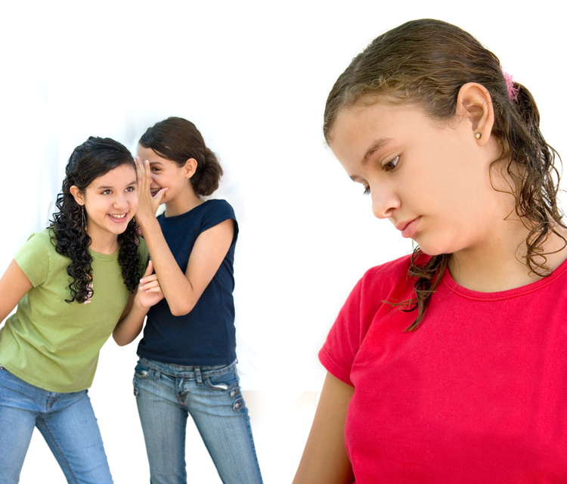
Words Hurt
Pro-social Behavior Movement

Slide 2
Bullying In Our Schools
Statistics show that among 4th through 8th graders, 90 percent have reported being victims of some kind of bullying.
There are about 71 percent of students that report bullying as an on-going problem. (Bullyingstatistics.org)
Recently a 14 year old student committed suicide on Friday at a local jr high because of bullying

Slide 3
How We Taught Our Lesson at Viewmont
First we had a skit to introduce why we were there.
Random kids drew out a word and had to say that word out loud. Nice words were put in recycling bin. Bad words were put in trash
Personal bullying stories.
We let the kids share their stories and comments.
Ended on a positive note

Slide 4
How we taught our lesson at Midvale elementary
We did a name calling skit to introduce the reason we were there
We did a name calling game to interact with the kids.
Shared personal stories with the kids
Took kids comments
Finished with a story “Crayon Box That Talked”

Slide 5
What Viewmont wanted us to talk about in addition
There is a difference between bullying and teasing. Also with nicknames there is good and bad.
We explained that bullying is entirely a one-way street. Bullying only leads to harm
Teasing can be playful or mean between friends.
Make sure there is no harmful words said
Nicknames are only good if the person is okay with them.
Not to be afraid to stand up for the people being bullied

Slide 6
Things that Midvale wanted us to talk about
When joking just because you add “just kidding” at the end of a comment does not mean it excuses the rudeness
Talking about someone’s parents with “yo mama” jokes.

Slide 7
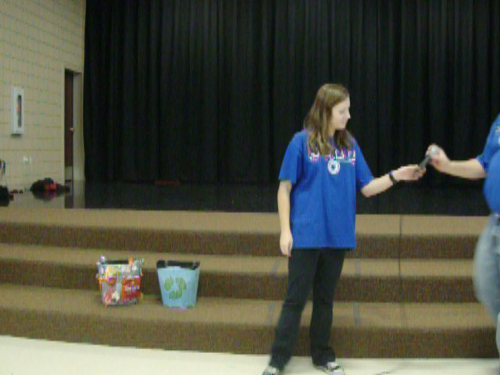

Slide 8
Comparison
Viewmont Elementary vs. Midvale Elementary
Is there a difference when it comes to how the schools react to an anti-bullying group?
How did the children react?
How did the teacher react?

Slide 9
Foot Print
We left posters in the hall ways to keep the message in their minds.
Gave the students pencils and a pamphlet to share with their parents.
The great message that “Words Hurt”

Slide 10
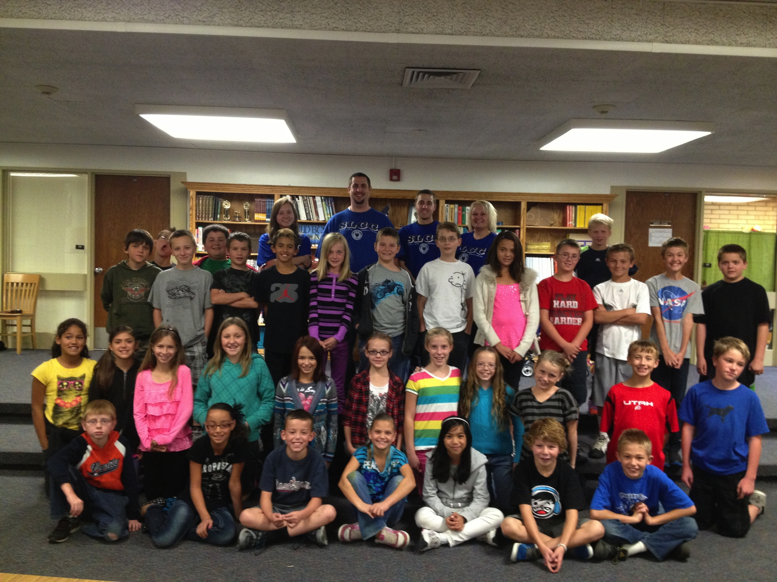

Slide 11
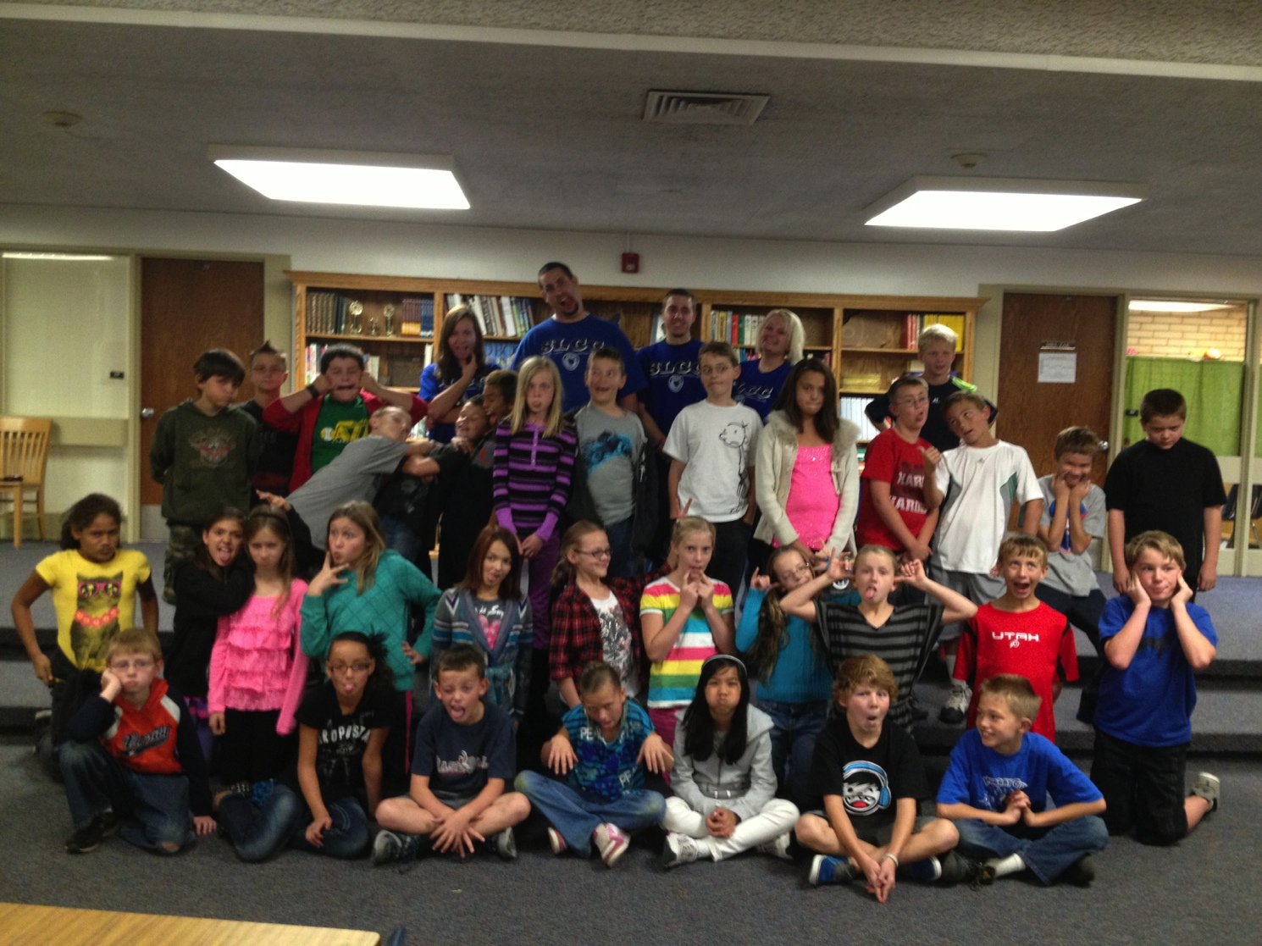

Slide 12
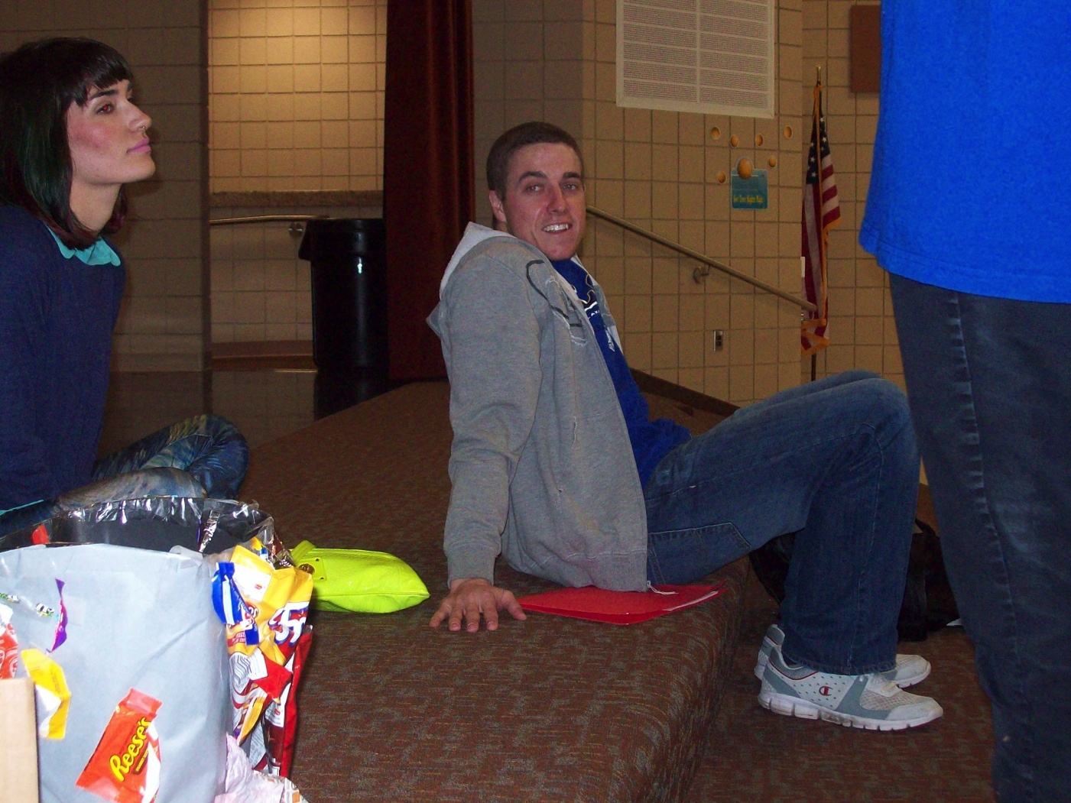
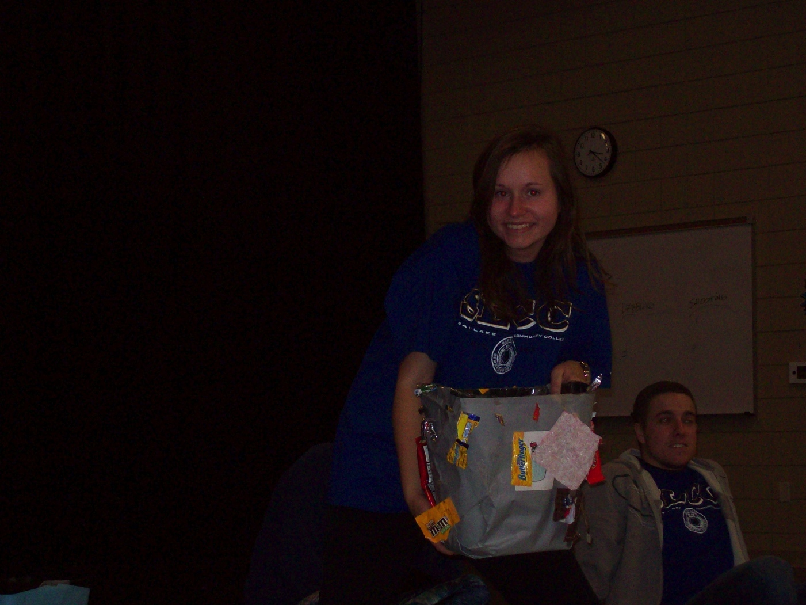
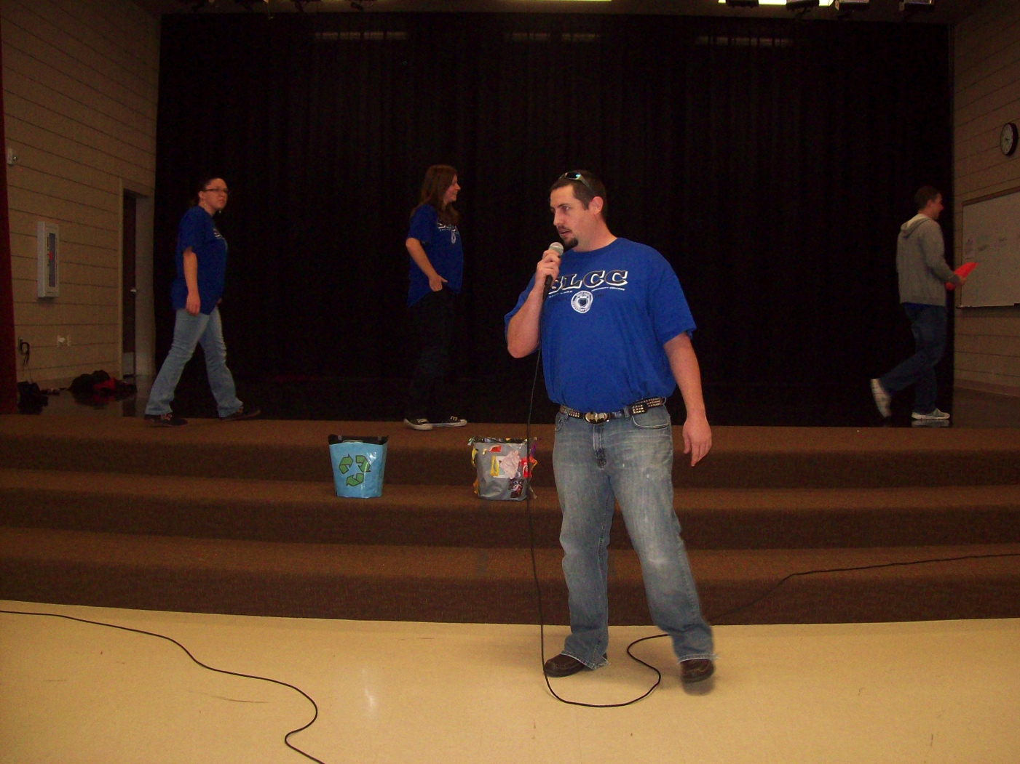
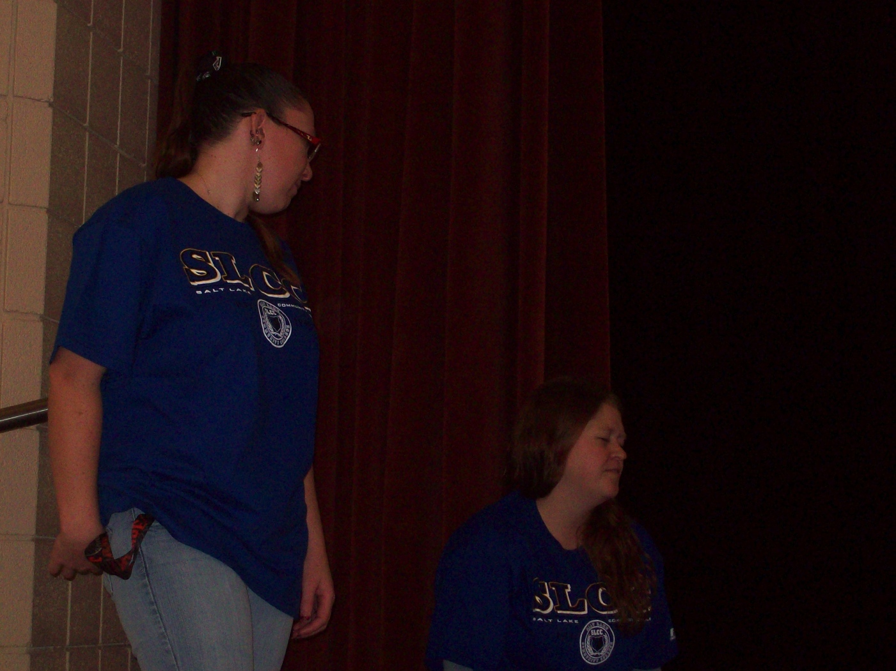

Slide 13
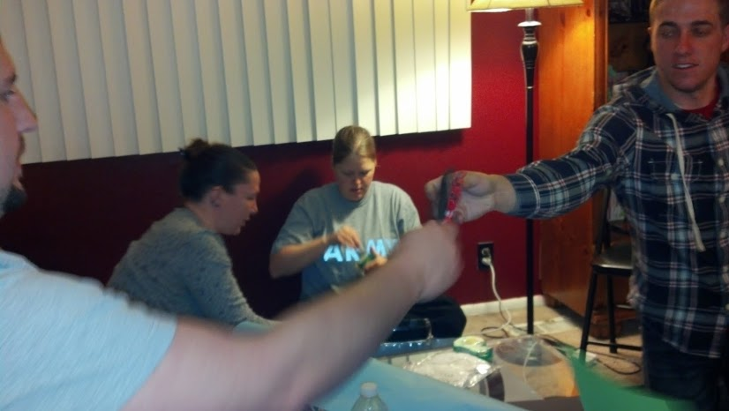
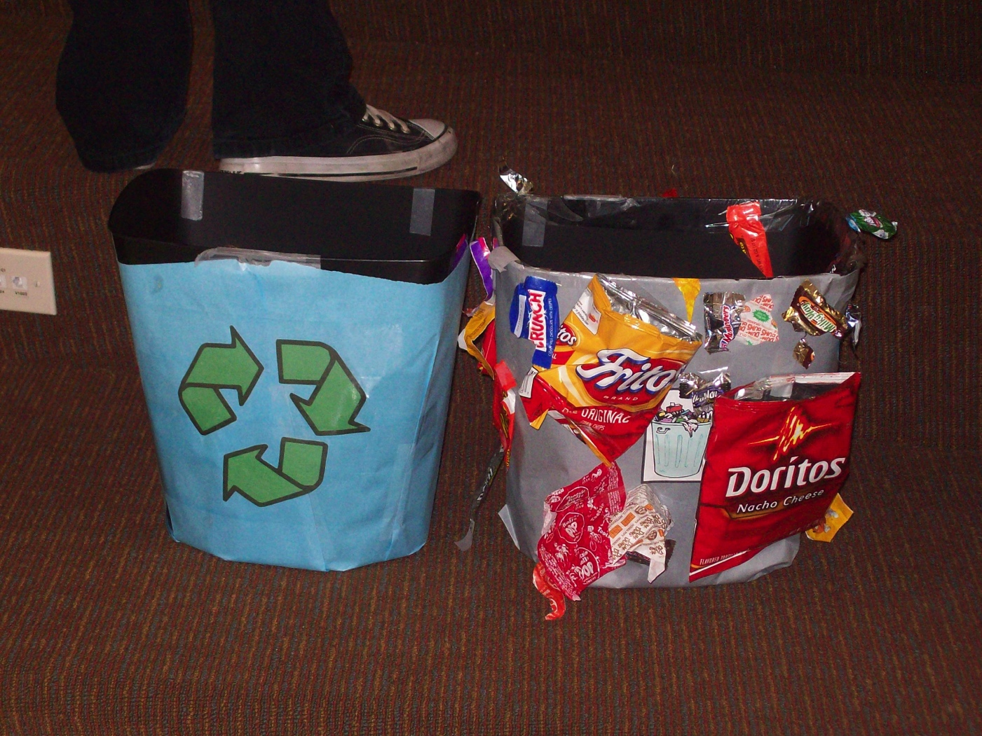

Slide 14
Personal Connection
Going into this I was very excited with the process and the results did not disappoint: Kirtus
I thought it turned out to be a great program and had a strong message to get out: Ben
I enjoyed the the personal affect it had on my son and the way it made him feel: Rebecca
Bullying follows you for life, I enjoyed making a difference in the children's lives: Alex
Observing the children in the assembly gave me a great feeling that we were doing some good: Amanda

Slide 15
Continued
I like that we were able to help some kids even if we could not reach all of them: Isamar
I was pleasantly surprised with the way the children interacted with us asking questions while we were doing our program: Sheena
I was happy with the surveys and how the children gave us positive feed back: Samantha
I think we just scratched on the topic, but we did have a positive effect: Sarah Lee

Slide 16
This was given by
Amanda Mae Bell
Kirtus Thacker
Sheena Christison
Ben Richards
Isamar Medeina
Samantha Snow
Sarah Lee
Alex Self

